Slide 1
HEALTH CARE ADVISOR
Under Guidance of:
xyz
Presented By :
xyz

Slide 2
Content
Introduction
Objective
Motivation
Feasibility Study
Requirement Analysis And Specification
System Design
Snapshots
Conclusion

Slide 3
Introduction
This project is to implement a Web based Healthcare Advisor System. It uses a set of disease based on the set of symptoms using DBMS concepts.
This system will help the users to identify certain diseases by answering certain questions asked by the system such as age, sex, risk factors etc.
Based on the diagnosis received, the user will be getting some suggestion of Lab test, precautions and suggests medicine that are available at the local chemist if required prescribe an advice to visit the doctor. The database will be developed with open source software.
This application will also provide online help to the patients to get more detail about the already diagnosed disease.

Slide 4
Objective
To diagnose disease based upon symptoms.
To record patient’s data and diagnosis.
To increase accuracy and reliability.
To act as disease and symptoms repository.
To provide information about medicines, precautions of diseases to the patients.

Slide 5
Motivation
With the growing number of diseases and their symptoms, everyone cannot manage to be updated with the disease, its symptoms, cure, medicines etc. Due to hike in Doctor’s fees, everyone cannot afford fee and treatment charges.
This System is developed taking this fact in mind. This system will provide proper guidance when the user specifies the symptoms of his illness. There are some other features like enquiry about disease, symptoms, medicines, and cure with many doctors. User will get report on the basis of the symptoms. User can search for doctor’s help at any point of time. User can talk about their illness and get instant diagnosis. System will provide medication, diet chart, exercises based upon report of end user

Slide 6
Feasibility study
Technical Feasibility
The technical feasibility in the proposed system deals with the technology used in the system. It deals whether the hardware and software used in the system are of the latest technology or not. It happens that after a system is prepared a new technology arises and the user wants the system based on that technology.
This system use windows platform, HTML, CSS, Bootstrap and Java script as front end technology and Microsoft MySQL and PHP as backend technology. Thus, “ Health Care Advisor ” is technically feasible.

Slide 7
Economical feasibility
Economic analysis is the most frequently used method for evaluating the effectiveness of a new system. More commonly known as cost/benefit analysis. Microsoft MySQL database easily available on the internet.
Operational Feasibility
The project has been developed in such a way that it becomes very easy even for a person with little computer knowledge to operate it. This software is very user friendly and does not require any technical person to operate .The model is easy to handle and user compatible. Thus, the project is operationally feasible.

Slide 8
Requirement analysis and specification
Patient Module
For the patient login there would be two parts, one is for the new registration and one for the already registered user. Here users have to give email and password to login to the system. We had used SQL database which is used to save patient details.
Disease Prediction Module
Patient will specify the symptoms caused due to his illness. System will ask certain question regarding his illness and system predict the disease based on the symptoms specified by the patient. A detailed description about the disease, symptoms, medicine and precaution is also provided by website.

Slide 9
Hardware Configuration
The section of hardware configuration is an important task related to the software development insufficient random access memory may affect adversely on the speed and efficiency of the entire system. The process should be powerful to handle the entire operations. The hard disk should have sufficient capacity to store the file and application.
Processor : Pentium IV and above
Processor speed: 1.4 GHz Onwards
System memory: 128 Mb minimum 256 Mb recommended
Cache size: 512 KB
RAM: 512 MB(Minimum)
Network card : Any card can provide a 100mbps speed
Network connection: UTP or Coaxial cable connection
Hard disk: 80Gb

Slide 10
Software Configuration
A major element in building a system is the section of compatible software since the software in the market is experiencing in geometric progression. Selected software should be acceptable by the firm and one user as well as it should be feasible for the system. This document gives a detailed description of the software requirement specification.
Front end tool: HTML, CSS, Bootstrap, Java script
Database Server: MySQL
Operating system: Windows 10
Server Side Language: PHP
Web Server : Apache HTTP Server

Slide 11
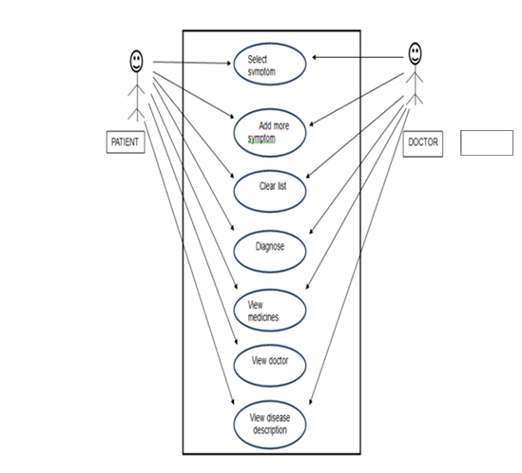
System design
Use Case Diagram

Slide 12
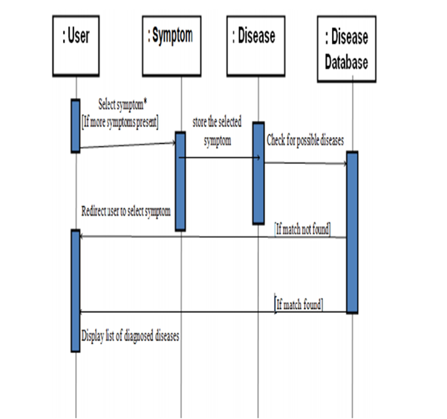
Sequence Diagram

Slide 13
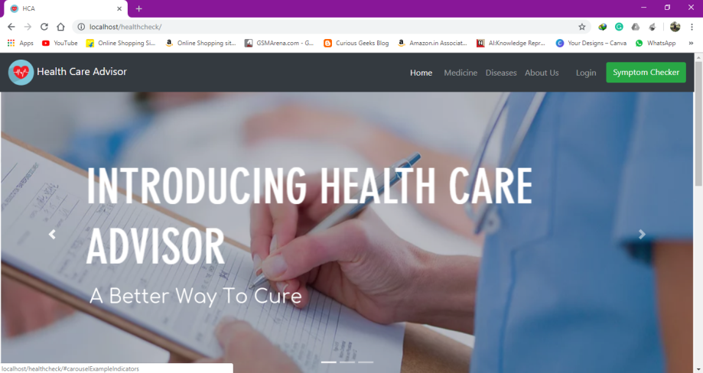
Snapshots Homepage

Slide 14
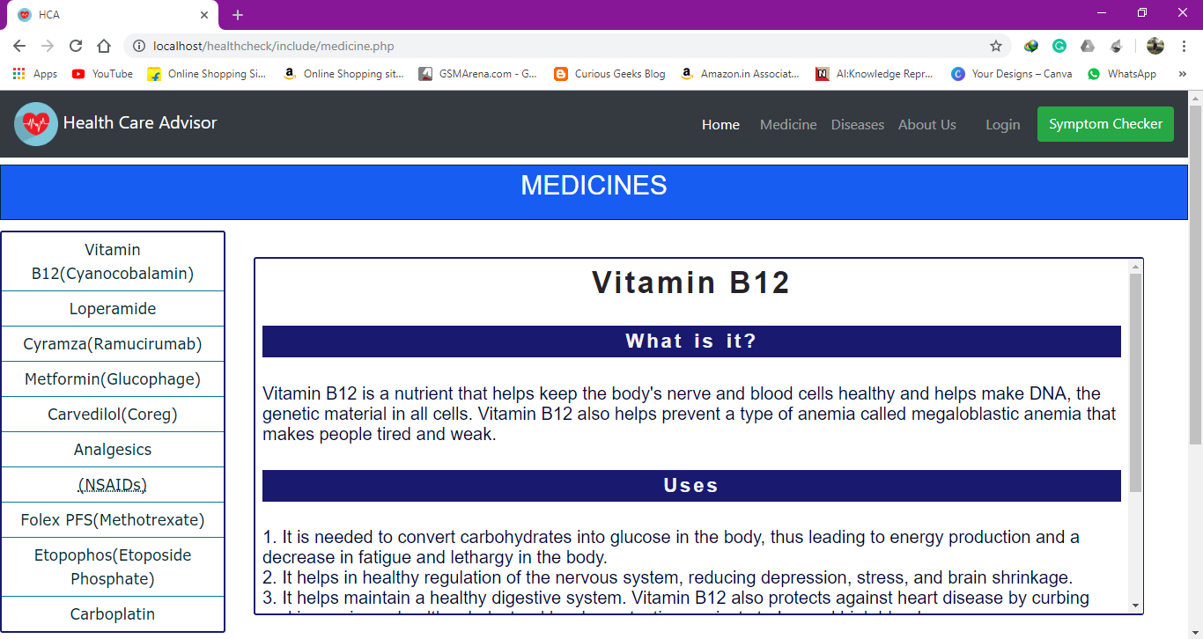
Medicine Page

Slide 15
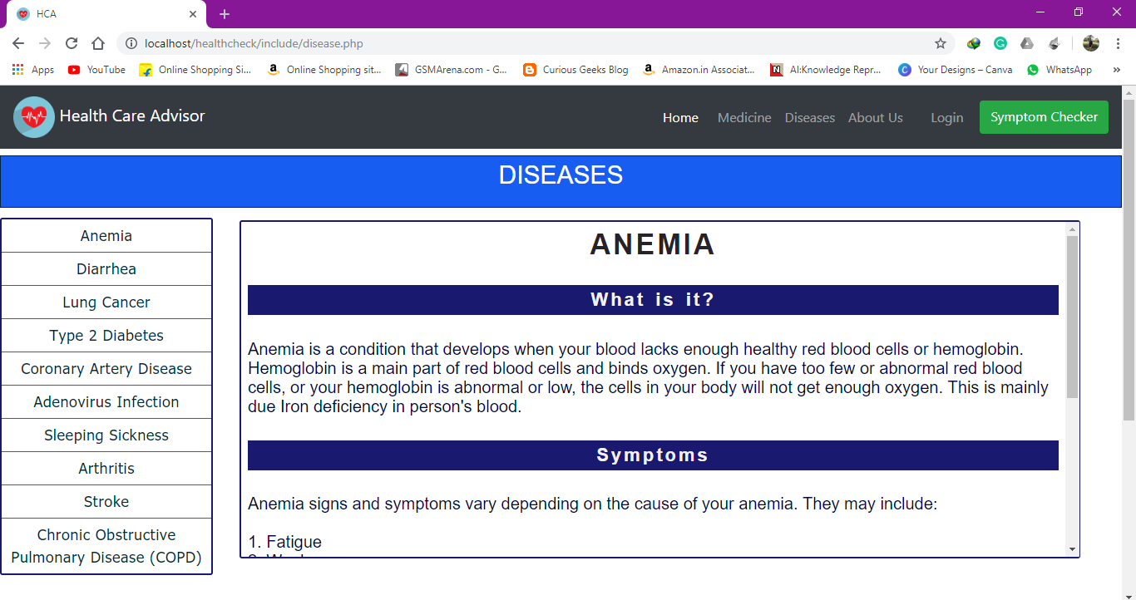
Disease Page

Slide 16
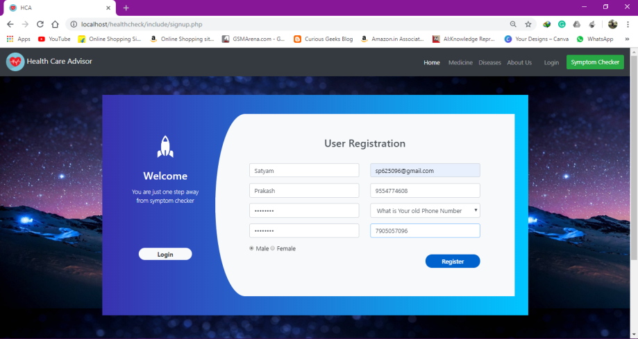
Sign up Page

Slide 17
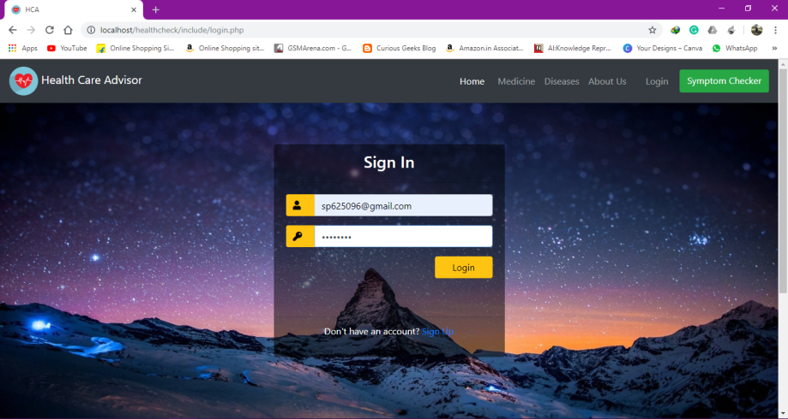
Login Page

Slide 18
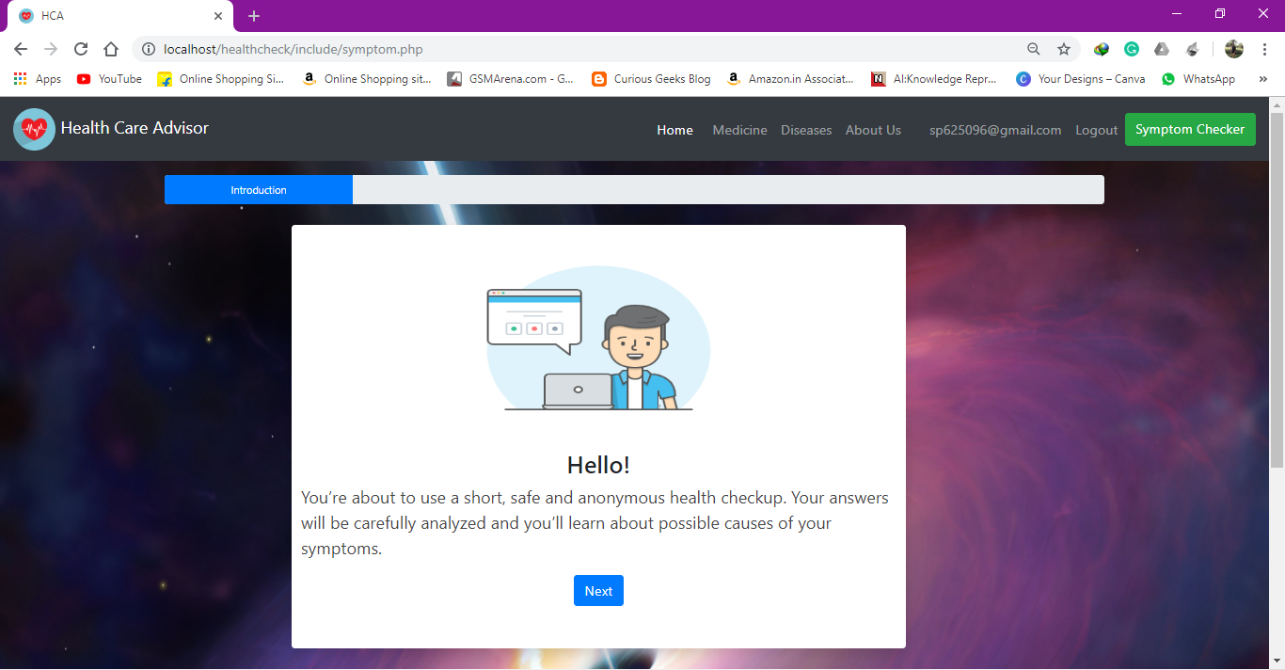
Symptom Checker Main Page

Slide 19
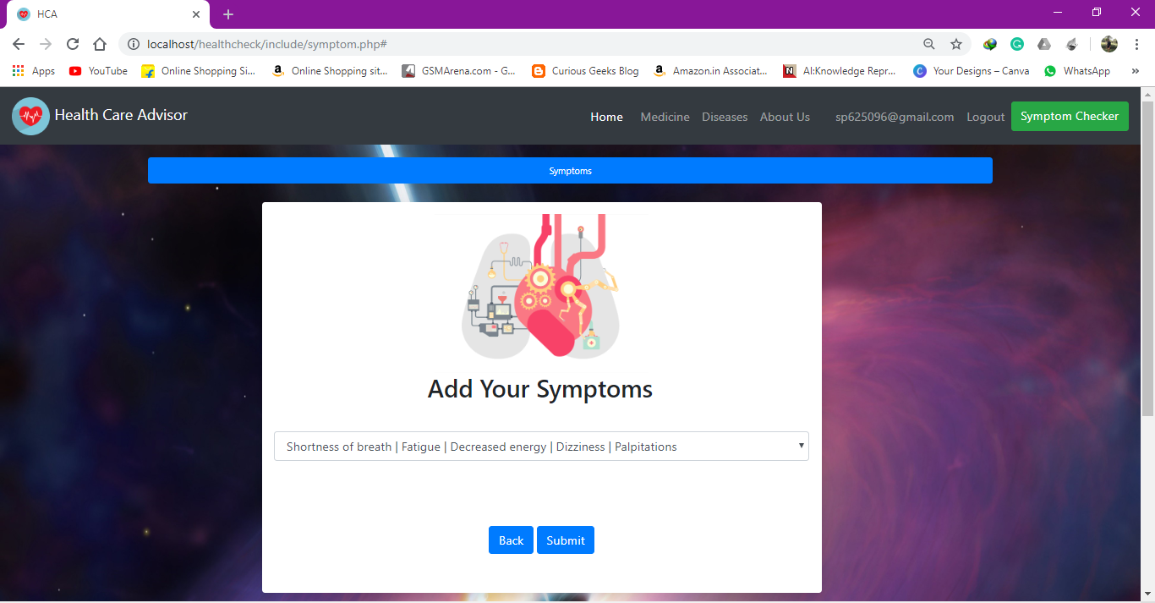
Add Symptom Page

Slide 20
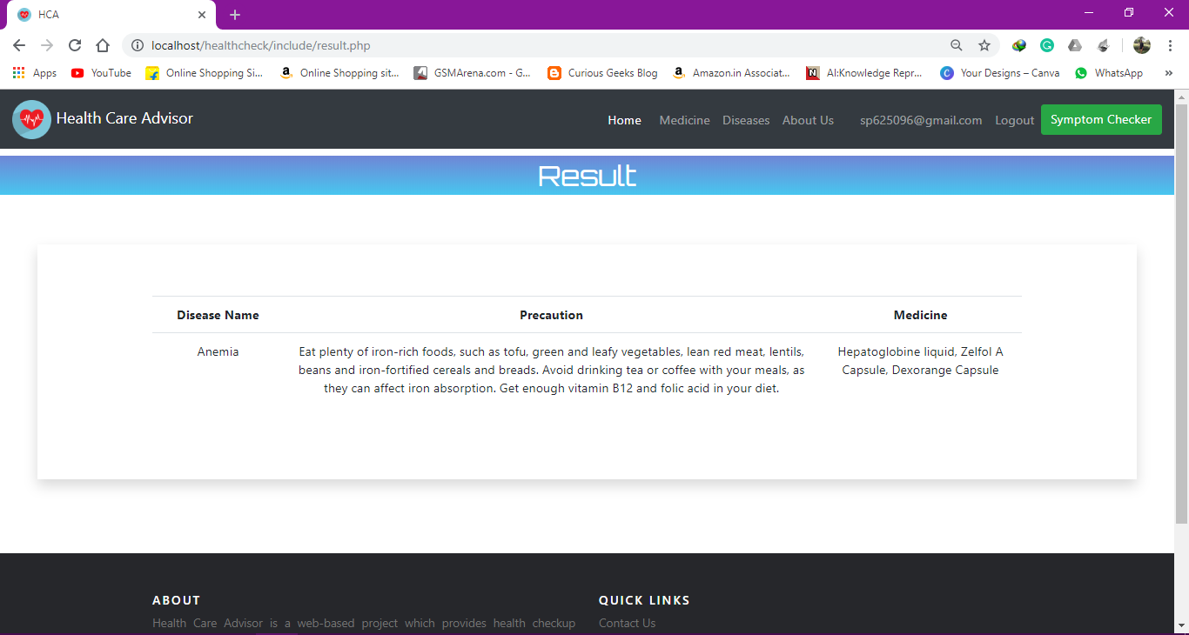
Result Page

Slide 21
Conclusion
In this project we had proposed a website which will make use of technology for health diagnosis. The website will prove useful in urgent cases where patient is unable to reach doctor, for emergency cases that do not have doctors in an area, during late night emergencies and also for preliminary examination of patients. This project has large scope as it has following features:
Automation of Disease Prediction.
To save the environment by using paper free work.
To increase the accuracy and efficiency so that patients can get direct help.
Management of disease related data.

Slide 22
Special Thanks to xyz

